Slide 1

Risk Management in Software Projects
Risk management is a critical process for software engineering projects, ensuring they meet deadlines, budget, and quality standards.
by arthi arthi
aa

Slide 2

Identifying Risks in Software Engineering
1
Technical Risks
2
Project Management Risks
These include issues related to technology, such as outdated frameworks or inadequate infrastructure.
These encompass factors like poor communication, lack of resources, or unrealistic timelines.
3
Business Risks
4
Human Risks
These are external factors that can affect a project, such as market changes or competitor actions.
This includes factors like skill gaps, lack of motivation, or high turnover rates.

Slide 3
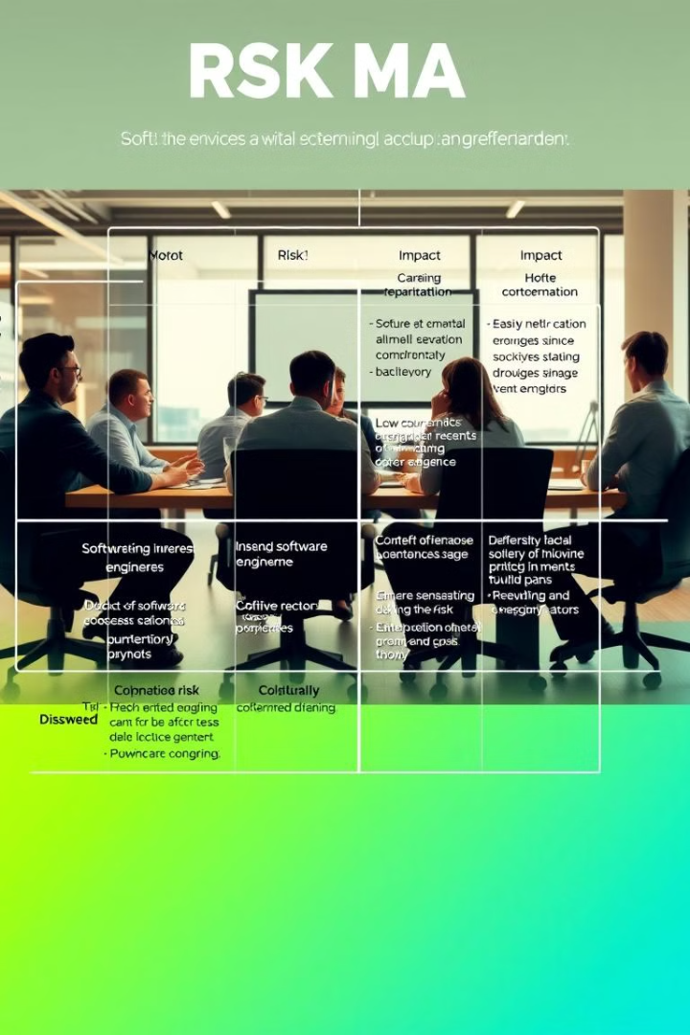
Assessing and Prioritizing Risks
Risk
Probability
Impact
Priority
Outdated Technology
High
High
High
Lack of Communication
Medium
Medium
Medium
Market Changes
Low
High
Medium

Slide 4

Developing Risk Mitigation Strategies
Risk Avoidance
Risk Mitigation
This involves eliminating the risk altogether, such as choosing a different technology or avoiding a specific feature.
This aims to reduce the probability or impact of a risk, for example, by implementing a robust testing process or having backup resources.
Risk Transfer
Risk Acceptance
This involves shifting the risk to another party, such as through insurance or outsourcing.
This involves acknowledging the risk and accepting its potential consequences, often when the cost of mitigation is too high.

Slide 5

Implementing Risk Management Processes
1
Risk Identification
Continuously identify new risks as the project progresses.
2
Risk Assessment
Evaluate the likelihood and impact of each identified risk.
3
Risk Response Planning
Develop strategies to address each risk based on its severity.
4
Risk Monitoring and Control
Track the effectiveness of mitigation strategies and adjust plans as needed.

Slide 6
Monitoring and Reviewing Risks
Risk Register
Risk Reporting
Risk Audits
Maintain a comprehensive record of identified risks, their likelihood, impact, and mitigation strategies.
Regularly communicate the status of risks to stakeholders, including progress made and any new risks identified.
Periodically assess the effectiveness of risk management practices and identify areas for improvement.

Slide 7




Communicating and Reporting Risks
Internal Communication
Sharing risk information within the development team and project management.
Stakeholder Communication
Keeping key stakeholders informed about potential risks and mitigation strategies.
External Communication
Communicating risks to clients or other external parties as needed.

Slide 8

Conclusion and Key Takeaways
Effective risk management is crucial for successful software projects. By identifying, assessing, and mitigating risks, organizations can enhance project success and minimize potential disruptions.

